Slide 1
STJG Transit
www.yourwebsite.com

Slide 2
Goal
propose a digital solution: the development of an integrated web and mobile platform that aims to digitalize all aspects of the company’s operations. This platform will streamline trip management, improve driver-passenger interaction, enable real-time tracking, and support secure, modern payment systems—ultimately transforming STJG into a more efficient, transparent, and user-friendly service provider.

Slide 3
PLAN
01
Introduction
02
Tools & Technologies
03
Architecture
04
Team Structure
05
Conception

Slide 4




Technologies
Spring Boot: Used to build a secure and scalable backend API with Java.
React Native: Used for developing cross-platform mobile apps with native performance.
Angular: Used to create a dynamic and responsive web interface.
SQL: Used to manage and store structured data efficiently.

Slide 5

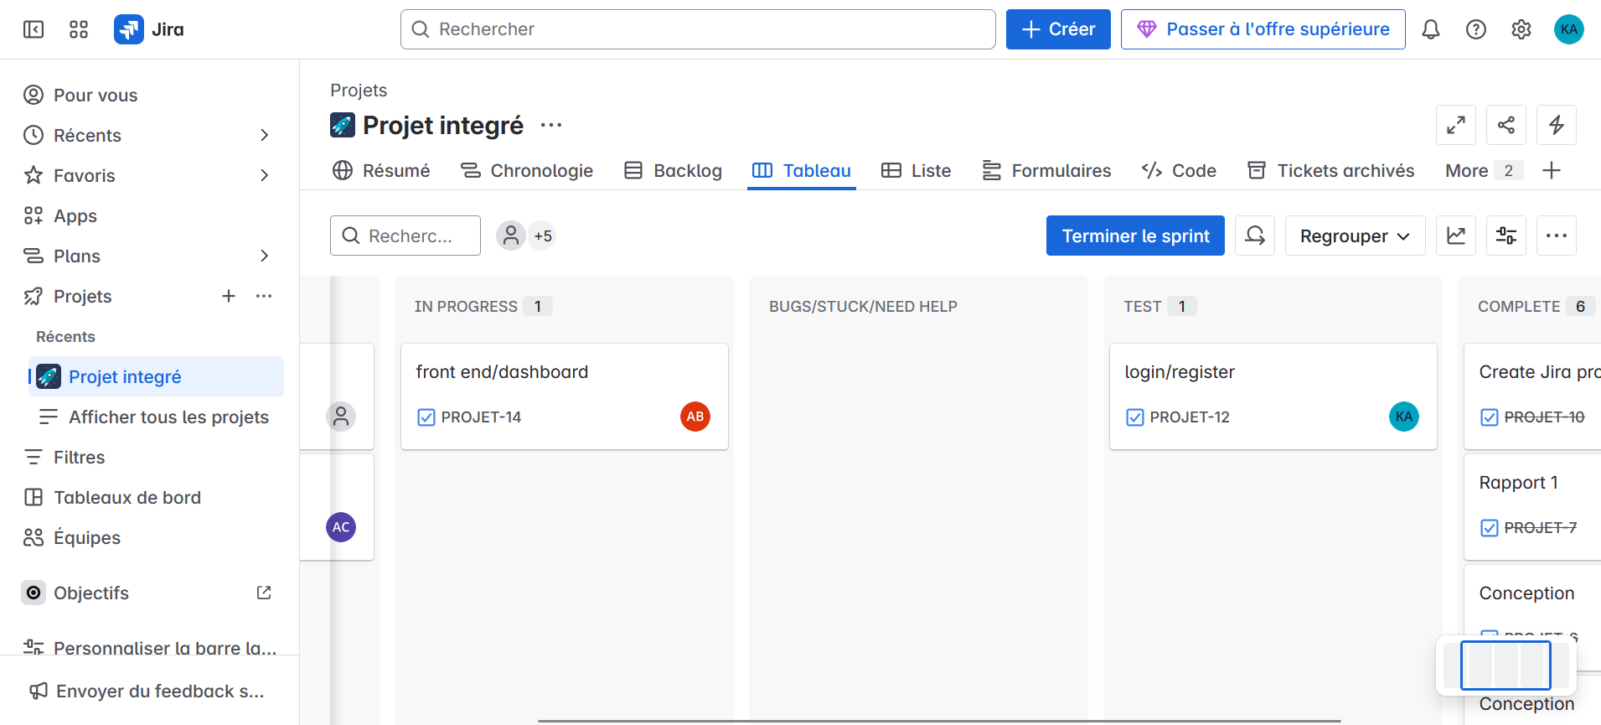
Communication tools
Jira: Used to plan, track, and manage project tasks and progress.

Slide 6

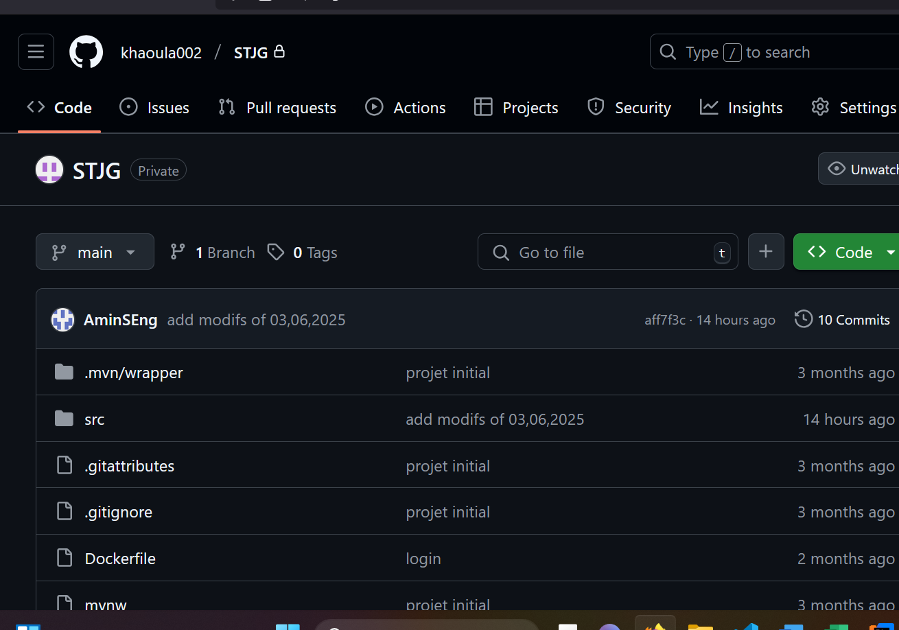
Communication tools
GitHub: Used for version control and collaborative code management.

Slide 7

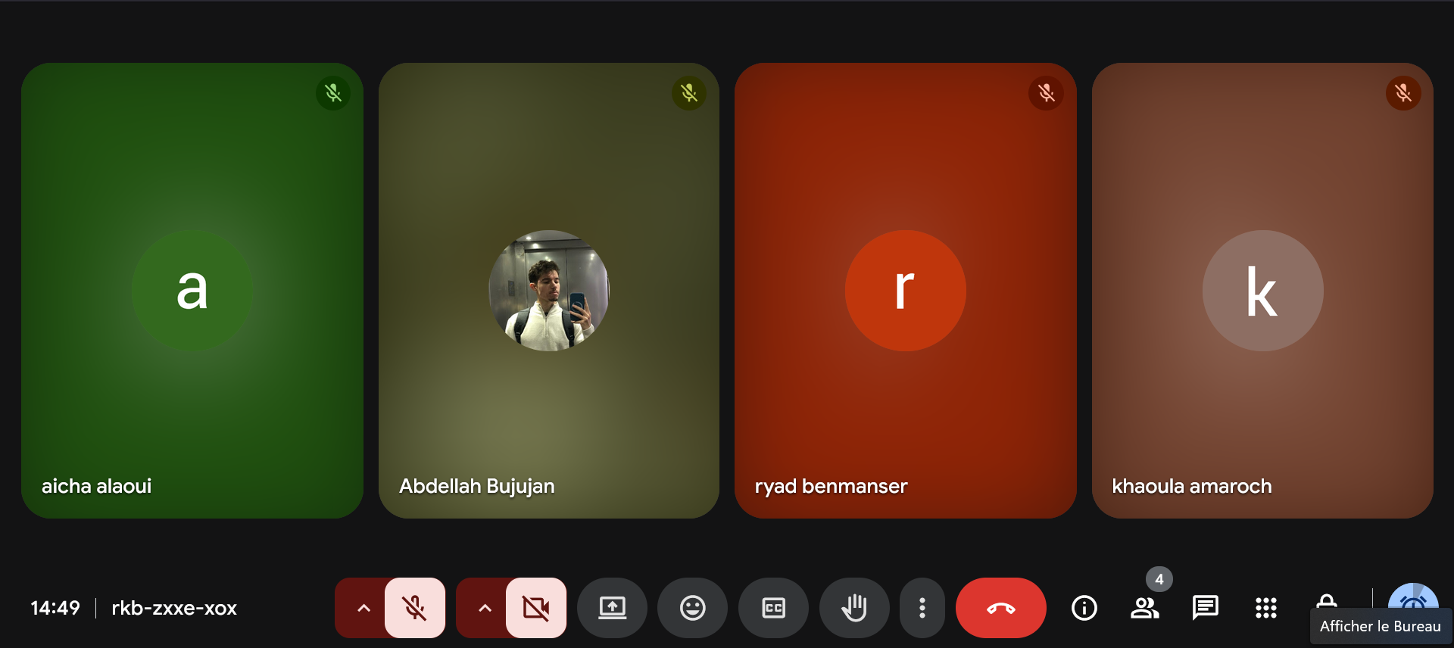
Communication tools
Google Meet: Used for virtual meetings and real-time team communication.

Slide 8
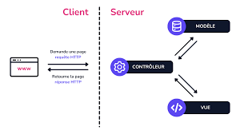
Project Steps
Architecture MVC :
FINISH
Your subtitle text here
Client Side (Browser)
Server Side (MVC Structure)
Controller
Receives the HTTP request from the client.
Determines what action to perform (e.g., retrieve or update data).
Model
The controller interacts with the model to get or update data.
The model communicates with the database and returns the results.
View
The controller sends the data to the view.
The view formats the data and generates the final HTML page.
This page is sent back to the client.
START

Slide 9
Team Structure
Conception Team: Responsible for analyzing the problem, defining requirements, and designing the system architecture.
Backend Team: Developed the server-side logic and APIs using Spring Boot and ensured database integration.
Frontend Team: Created the mobile app interface using React Native for smooth user interaction.
Web Team: Developed the responsive web interface using Angular to allow access from desktop platforms.

Slide 10
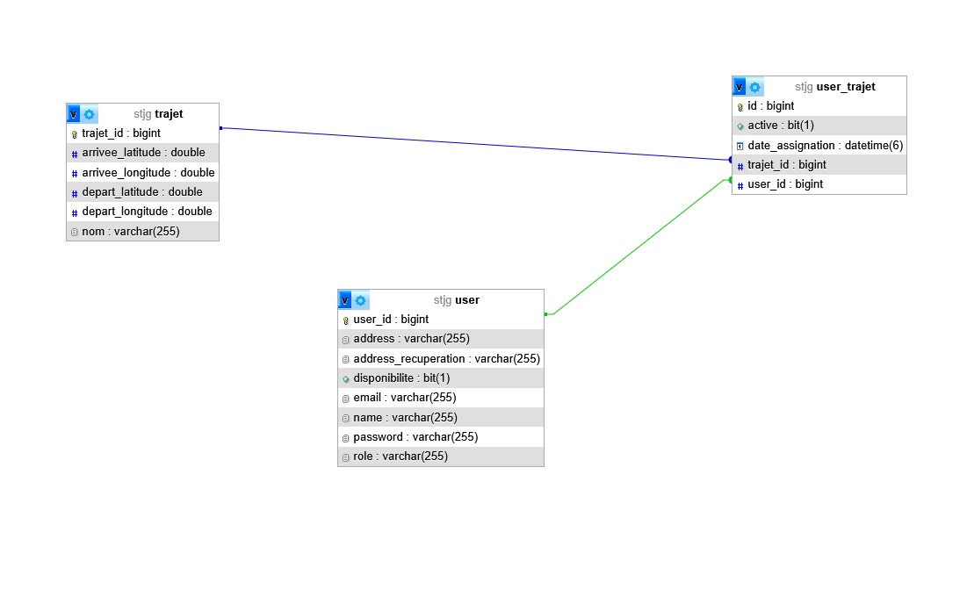
Conception: class diagram

Slide 11
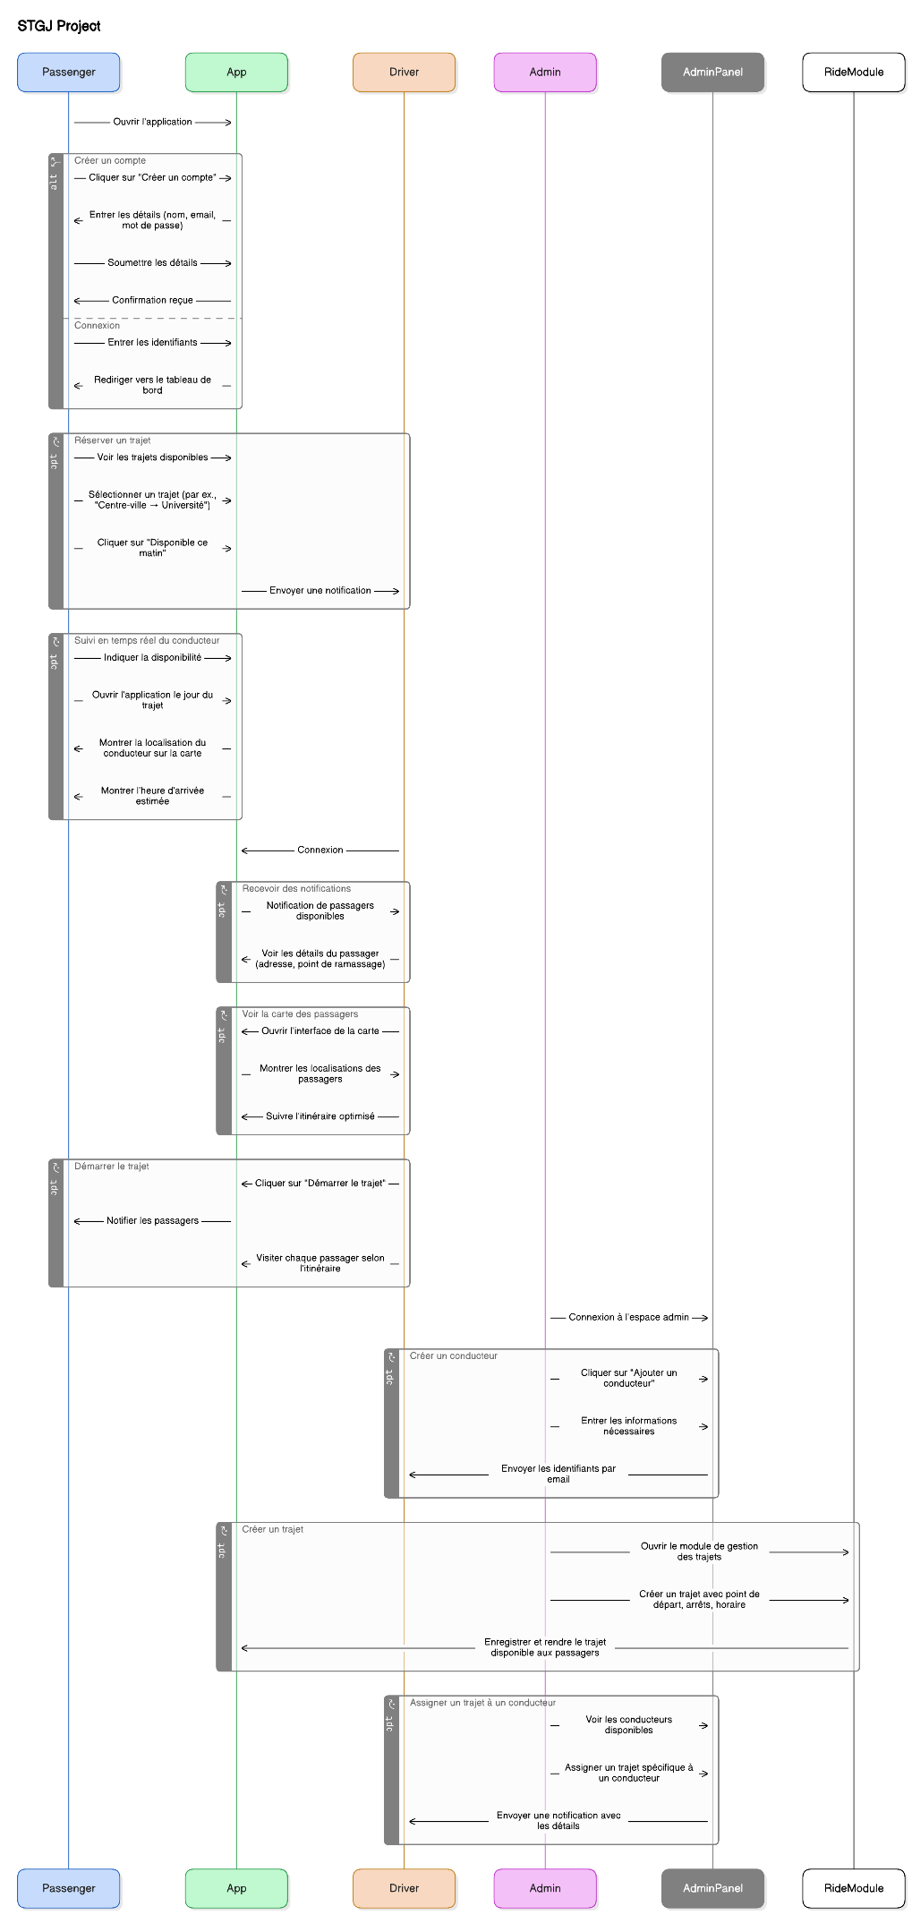
Conception: sequence

Slide 12
DEMO

